Slide 1
Automated Candidate SELECTION SYSTEM
Hush Hush
Recruiter
COURSE: ADVANCED PYTHON
Namrata Bhoyar
Anuj Kamble
Nihal Pujari
Pramodkumar Shivanna

Slide 2
Problem Statement
DOODLE’S HIRING PROCESS
Lengthy Application Procedure
Numerous Irrelevant CV’s
Agency Driven Chaos
Manual Screening
Loss Of Elligible Candidates
Poor Communication
2

Slide 3
Meet Hush Hush Recruiter
Automated Candidate Selection System
Discovers Candidates
Scores Them Intelligently
Supports Manager Evaluation
Notifies Results Automatically
2

Slide 4
User Personas
Candidate
Auto-Discovered
Shortlisted
Moved Forward After The Manager’s Decision
Hiring Manager
Identify Candidates Quickly
Reduce Screening Time
COO (Chief Operating Officer)
Controls Access
Monitors Pipeline Performance
4

Slide 5
Data Sources & Features
GitHub
Source: API
Model features:
total_stars
total_forks
commits_12m
StackOverflow
Source: Web Scrapping
Model features:
reputation
avg_score_per_answer
top_tags → engineered into tags
3

Slide 6



Data Sources & Features
Kaggle
Source: Web scrapping
Model features:
Upvotes
Usability
No_of_files
3

Slide 7
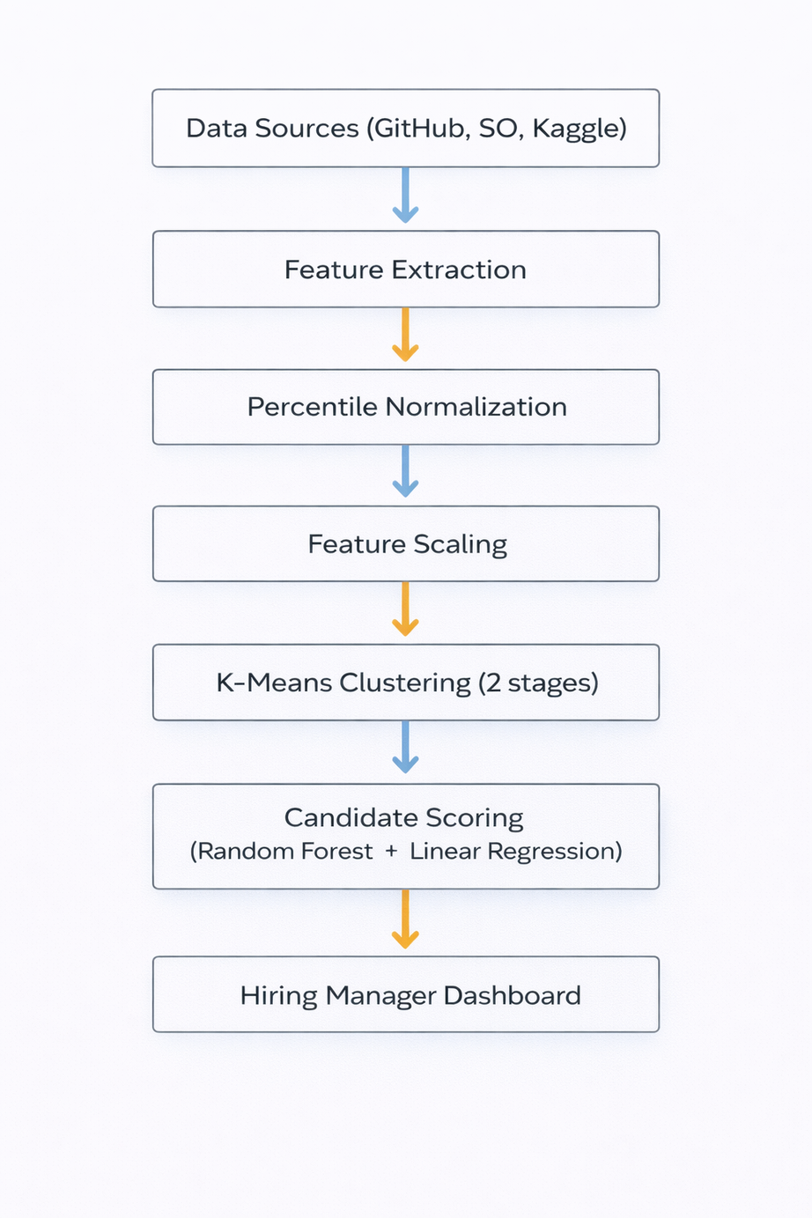
System Overview (Pipeline)
Collect profiles from GitHub, StackOverflow, Kaggle
Extract key signals (stars, reputation, upvotes, etc.)
Normalize + scale to make platforms comparable
K-Means (Stage 1): split into strong vs weak tier
K-Means (Stage 2): 3 profiles → Developer / Senior Developer / Solution Architect
Rank candidates per role using RF + LR signals
Hiring Manager reviews shortlist → Hire / Reject
If hired: account created + Candidate Portal access
5

Slide 8
Data Preprocessing & Featuring
Steps
Percentile Normalization
Feature Scaling (StandardScaler)
Result
Features become directly comparable across platforms and metrics
Reduces bias from very large numbers (e.g., stars, reputation)
7

Slide 9
Candidate Clusters
Candidate Tiering (K-Means k=2)
Purpose
Split the candidate pool into two groups: tier-1 and tier-2 profiles.
Method: K-Means Clustering
K-Means groups candidates based on similarity across normalized features
With k = 2, it forms two natural tiers in the data
Decision Rule
Only the tier-2 cluster is kept for the next stage
The tier-1 cluster is excluded from further scoring

Slide 10
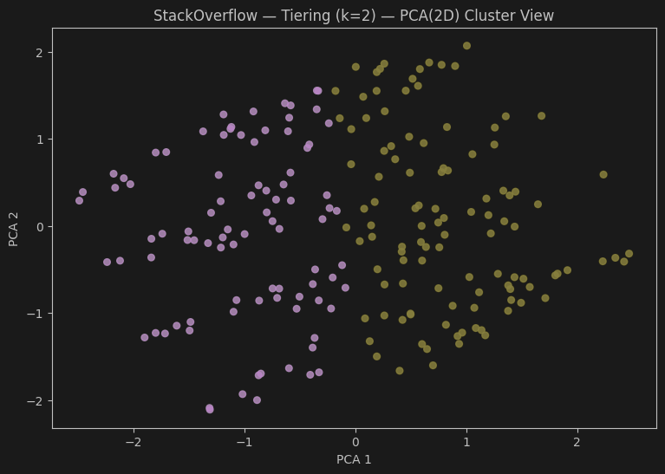

Slide 11
Role Profiling (K-Means k=3)
Cluster A
Cluster B
Cluster C
Developer
Senior Developer
Solution Architect
Second Clustering
We apply K-Means with k = 3 on the tier 2 cluster
Each cluster represents a different pattern of activity
4

Slide 12
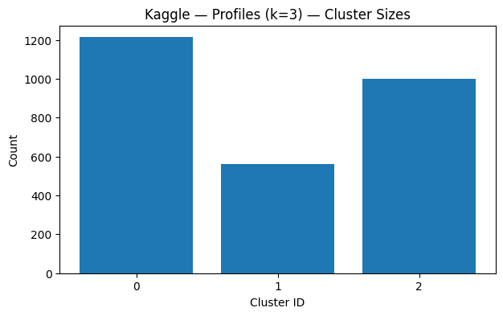

Slide 13
Candidate Scoring Model
Models Used
Random Forest Regressor(Performance Estimate)
Learns patterns in the features and predicts overall candidate strength.
Linear Regression (Profile Fit)
Measures how closely a candidate matches the characteristics of their cluster.

Slide 14
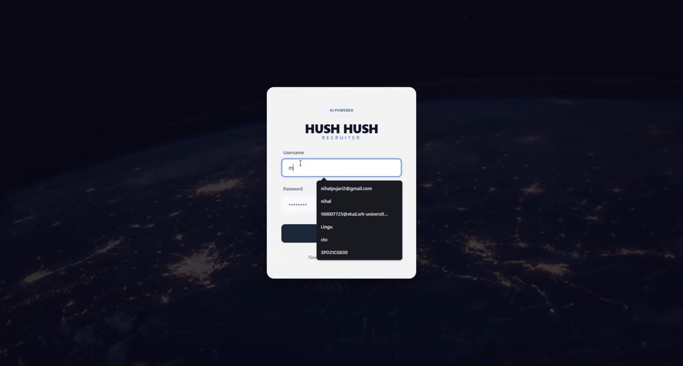

Slide 15
Learnings
Multi-source data is messy
Normalization is critical for fairness
Job role assignment can be data-driven
End-to-end system thinking
Future Work
Shortlisted candidates will receive secure login credentials via email to access the Candidate Portal, where the link to the final coding assessment will be published once available.
5

Slide 16
Conclusion
Developed an automated candidate shortlisting system
Combined multi-platform data (GitHub, StackOverflow, Kaggle)
Applied clustering and Machine Learning models to rank candidates
Performed automatic role assignment (Developer / Senior / Architect)
5

Slide 17
THANK YOU
5

